Slide 1
Intentional Interviewing
Go deeper in the interview with Behavioral Event Interview (BEI) concepts
Shauna lane
Ann carthel
Notes:
Shauna and Ann, feel free to add to or take away…you may want to watch in slide show mode so you can see if you like how it comes in and advances. My thoughts are you would spend ~10-15 mins on slides 1-5, ~10-15 mins on slide 6 (the interview), and ~10-15 mins on slide 7-8 and that would leave you some room to adjust as needed. Just my thoughts, but you ladies feel free to make it your own. Remember, this is just a taste of BEI and will we give the full spill on March 3rd. I’m thinking they would need a copy of handouts (I can submit these to Madalyn or wait and see if you guys want to make changes.) and possibly a flyer with a save the date for accountability and intentional interviewing on March 3rd.
This slide:
Welcome, today is the “trailer” for March 3rds Intentional Interviewing. So, if you like it and want to know more come back the afternoon of March 3rd for the full meal deal!

Slide 2
Which is more accurate?
Fortune Telling vs
Traditional Interview

Slide 3
Why BEI?
This is NOT the ordinary job interview.
Not for EVERY interview, rather used to help decipher between the finalists or will help you identify strengths/weaknesses of the “lone applicant”.
Our “default” mode is how we operate under pressure…so THAT is what WE NEED TO KNOW from the start!
Notes:
Research indicates that traditional interview techniques rarely uncover competencies that predict future performance differences. Often, job candidates speak in generalities about what they think they should or would do, not about what they actually do or did. In a BEI interview we dig to find out what the candidate did or does! BEI originated in the business sector in the 70’s and in 2008 Public Impact, a national education policy and management firm out of North Carolina, generated a BEI toolkit for use in public schools to best identify measureable distinguishers between very high performers and more typical or lower-performing leaders in a turnaround setting.

Slide 4
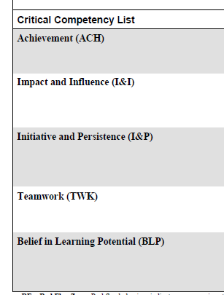
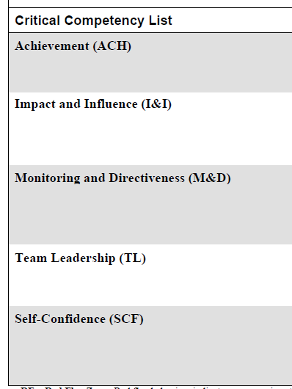
List 2-3 characteristics most important to you in a job candidate search, teacher and/or leader.
Teacher
Leader
1.
2.
3.
Notes:
Let participants have time to write down their top 2-3 wishes and share with their table. Then explain the Critical Competency List for Teacher and Leaders. When interviewing is you have an additional wish that doesn’t fit in one of these competencies you can add it to the bottom. The list was prepared by Public Impact by “mapping” the cross-sector research on turnaround teacher/leader actions to high-quality competency studies of successful entrepreneurs and leaders in large organizations.

Slide 5
What do you think is the BEST predictor of competency?
Research Says:
PREVIOUS DEMONSTRATION OF COMPETENCY!

Slide 6
Interview Steps
Introduction
Rapport
Set-up
Career Overview
Question(s)
Closure
Notes:
Explain the interview has these main parts and on March 3rd we will unpack each piece, but for today you are going to model the question part of what a BEI might look like. You need a story board (make it 3 chapters tops), then dig into the story. Remember: redeem the “we”, if they did or said something, ask What did you Think? If they thought or felt something, ask What did you Say? In demo, I would skip the career overview for the sake of time and point out this would be optional, for example if this was a second interview they would probably know this information, but if it were the one and only they may want to keep this part. Plus, more details to come for each part on March 3rd!

Slide 7
Would this method (BEI) or
a traditional interview
help you better identify
the 2-3 desirable characteristics
you listed at the beginning
of our session?
Notes:
Ask participants to look at the list they made at the beginning of the session and decide if this method would help them identify those characteristics better than traditional interview methods. What did they notice that was similar or different than traditional methods? Share out…

Slide 8
How Much Grit Do You Want?
Confidence | Competence
Reticent to Risk | Yet to Yes
careless
grit
Confidence
Reticent Risk
Join us March 3rd, 1-4
Intentional Interviewing
We will teach you how!
frozen
Yet Yes
Competence
Notes:
(Click on “grit” for link to grit TED talk.) “Grit” is becoming a buzz word and desirable for all professions. The TED talks about how to foster Grit, Lead4ward showed this graph about the outliers of grit and we think BEI will help you pick the “grittiest” from your applicant pool or better identify true strengths and weaknesses with the lone applicant.

